Slide 1
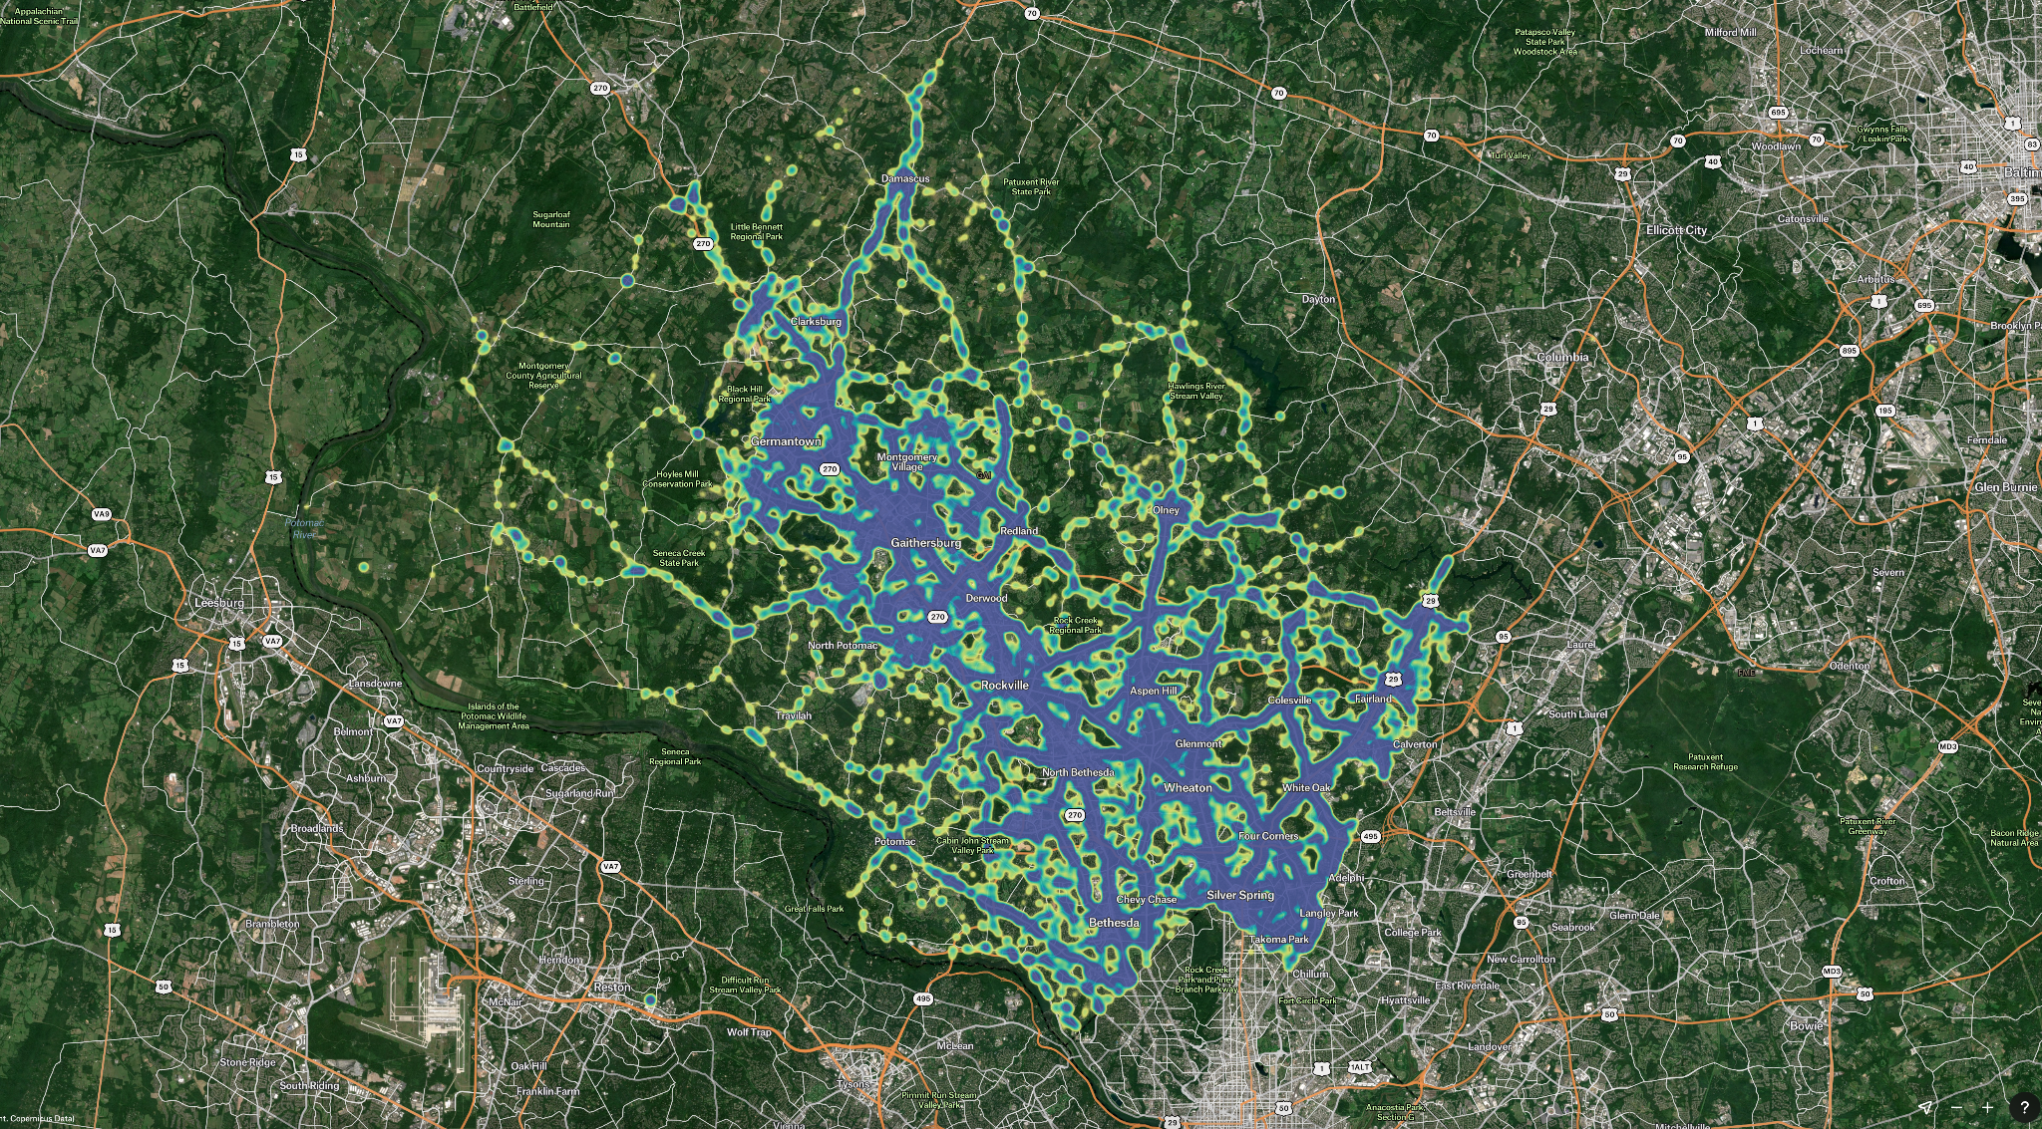
ML Research Project
Crash severity prediction of road accident
Researchers: Jim Cao, Corey Lin, Steve Wu,
Derek Shih, Jingwen Zhang
Dec. 10 2024
Picture generated on felt.com

Slide 2
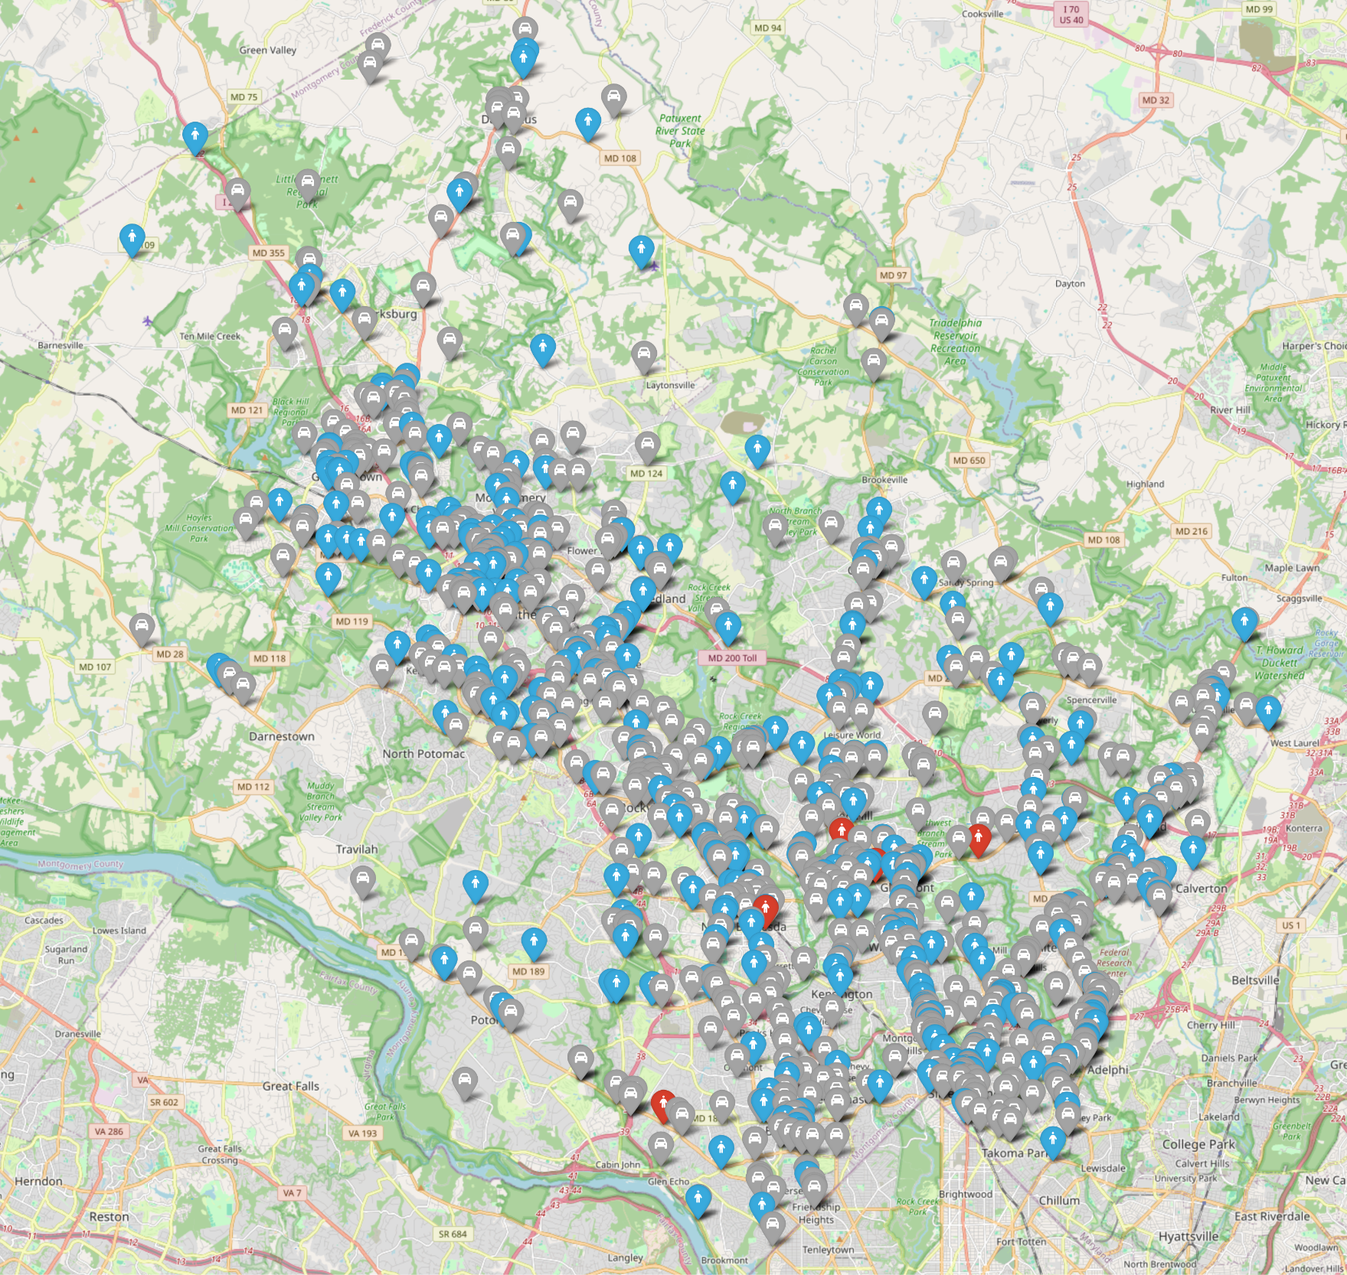
EDA - Explore the dataset
Random 1000 sample data
plotted in actual map
Gray: Property Damage Crash
Blue: Injury Crash
Red: Fatal Crash

Slide 3
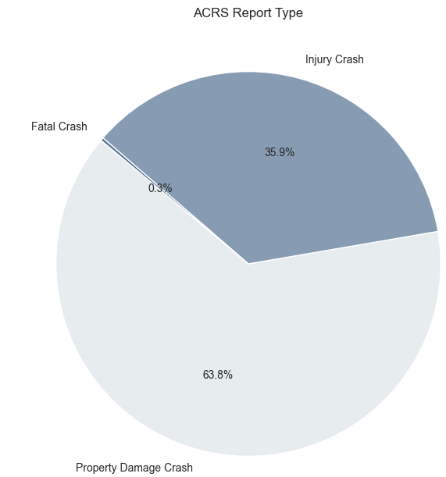
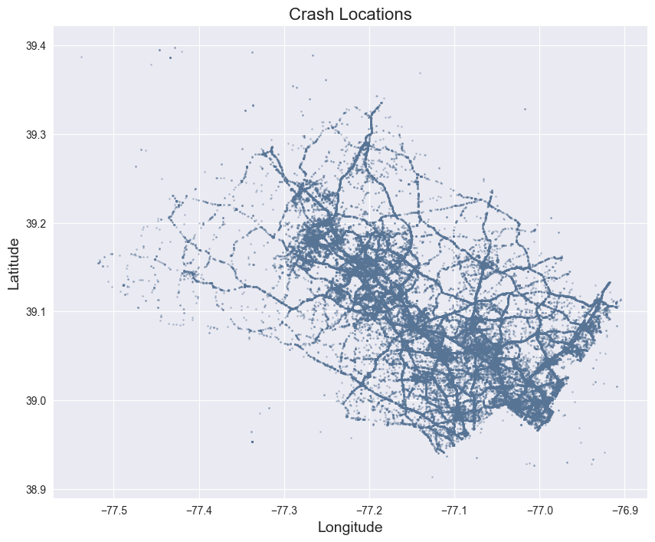
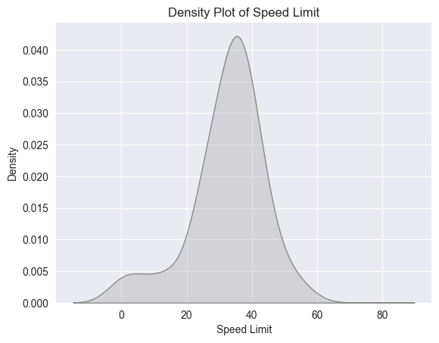
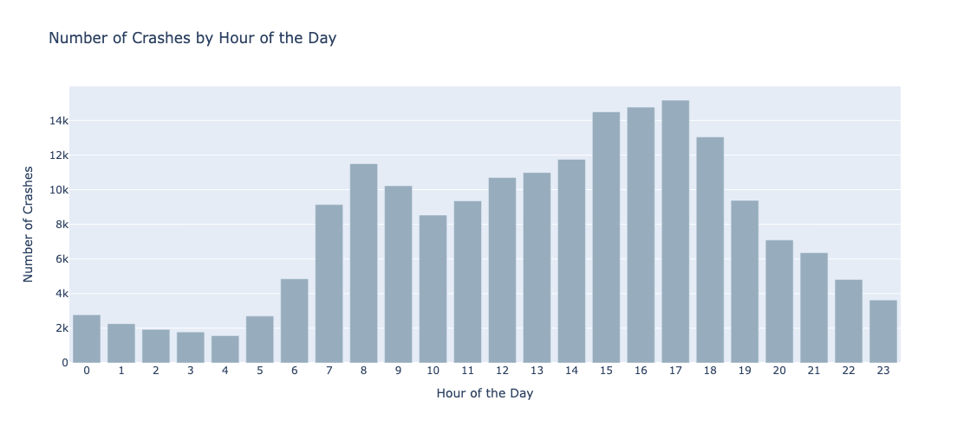
EDA
Numerical Elements

Slide 4
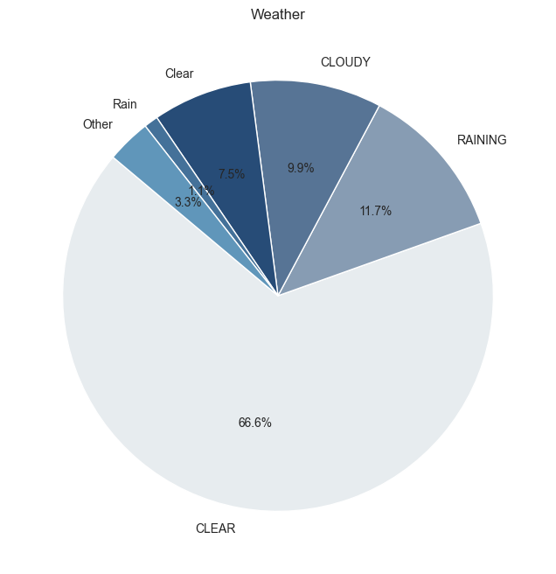
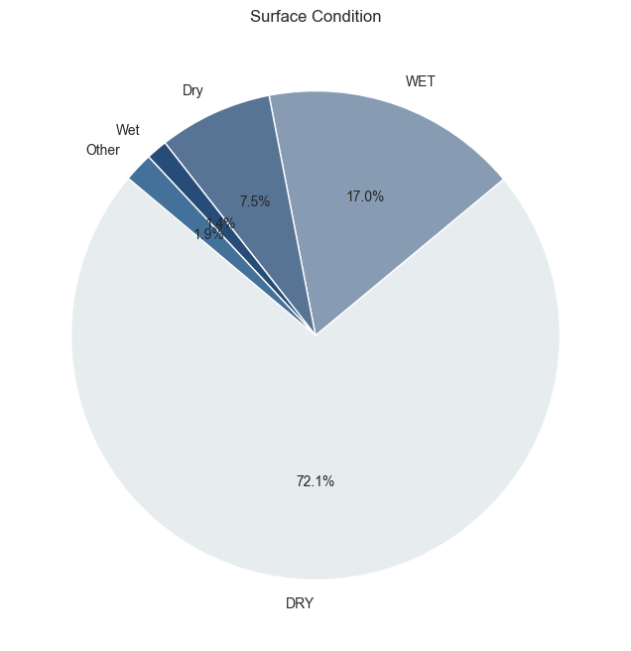
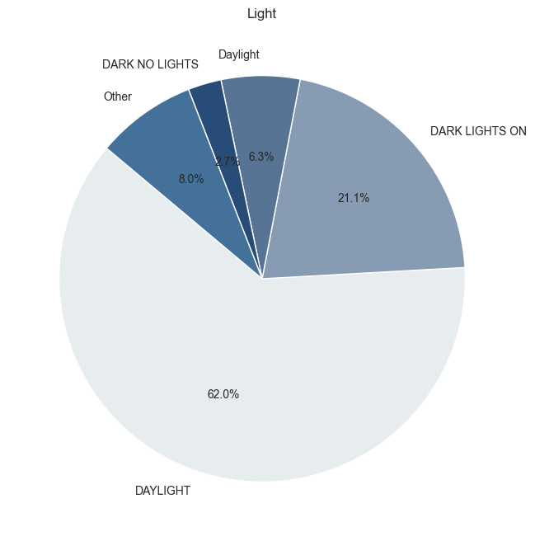
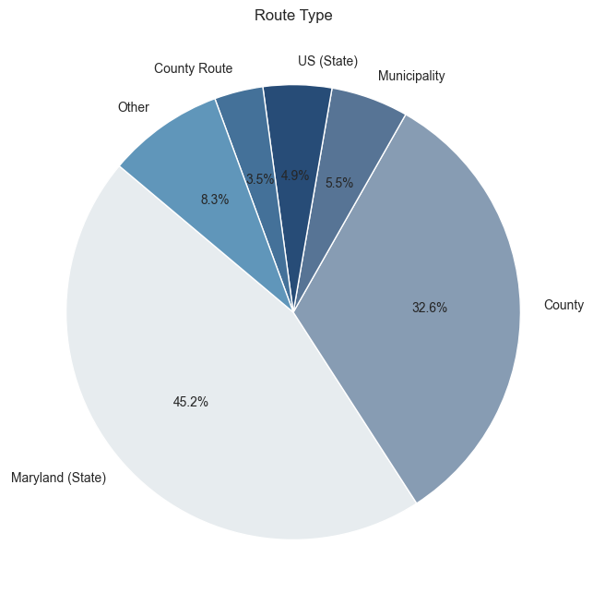

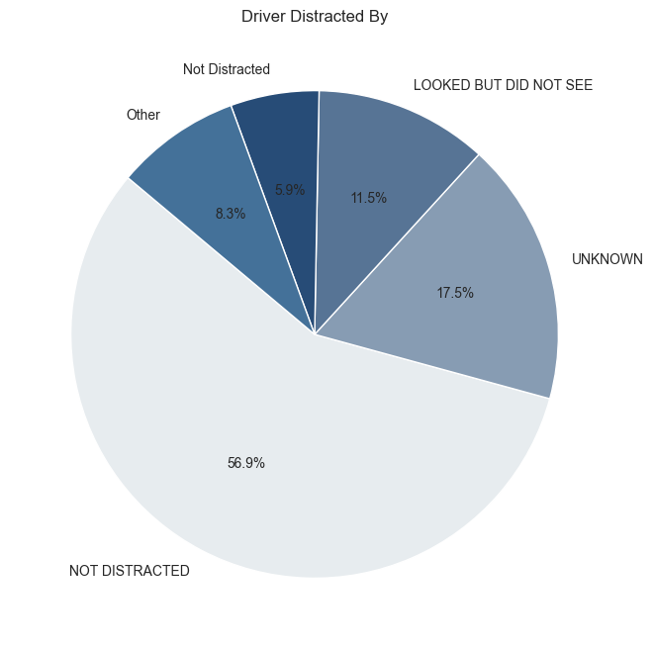
EDA
Environment Condition and Driver Behavior

Slide 5
Data Preprocessing
Improve Data Transformation and Data Imbalance Process
Highlights
Drop all columns with “Speed Limit” = 0
Z-score normalization for continuous variable “Speed Limit”
Transform the column “Crash Date/Time” into “Week”, “Weekend”, “Time”, “Month”, “Year”, “Date in Month”.
Drop all observations with null values
Train Test data split (70% 30%)
Handle imbalance in “ACRS Report Type” using SMOTE
1

Slide 6
Evaluation Matrix
The overall matrix will contribute to the selection of well-balanced model
Overall Accuracy: the ratio of correctly predicted samples to the total samples.
Overall Precision, Recall, and F1-Score:
Macro: Averages metrics for all classes equally.
Micro: Aggregates contributions of all classes (good for imbalance).
Weighted: Averages metrics weighted by class support.
ROC-AUC Score: for multiclass classification, calculate the ROC-AUC score using a one-vs-rest (OvR) approach.
Confusion Matrix

Slide 7
Model Performance
Random Forest perform best among the other five models in terms of all evaluation metrics
Model | Accuracy | Precision | Recall | F1-Score | ROC-AUC Score
Decision Tree | 0.6513 | 0.6562 | 0.6513 | 0.6534 | 0.6136
Logistic Regression | 0.3936 | 0.5722 | 0.3936 | 0.4610 | 0.6060
Random Forest | 0.7515 | 0.7527 | 0.7515 | 0.7520 | 0.8421
Bootstrap Aggregating | 0.5383 | 0.5461 | 0.5383 | 0.5414 | 0.5386
AdaBoost | 0.5475 | 0.5522 | 0.5475 | 0.5491 | 0.5888
XGBoost | 0.6330 | 0.6472 | 0.6329 | 0.6363 | 0.7457
Note: The precision score, recall score, and f1-score of AdaBoost and XGBoost were calculated using weighted average.
Notes:
For crash severity prediction, we used multiple models. Decision Trees offered interpretability, while Logistic Regression provided probabilistic insights. Random Forest, our best model, achieved the highest accuracy and ROC-AUC score, effectively handling complex interactions and class imbalances.
This table summarizes the performance of six models, with Random Forest excelling across accuracy, precision, recall, and F1-score. For feature selection, we identified 12 key factors with importance scores above 0.5, combining them with business logic. These include Latitude, Longitude, Time, Day of Week, Month, Weather, Lights, Road Name, Traffic Control, Speed Limit, Driver Substance Abuse, and Collision Type.

Slide 8
Model Performance
Random Forest perform best among the other five models in terms of all evaluation metrics
Model | Accuracy | Precision | Recall | F1-Score | ROC-AUC Score
Decision Tree | 0.6513 | 0.6562 | 0.6513 | 0.6534 | 0.6136
Logistic Regression | 0.3936 | 0.5722 | 0.3936 | 0.4610 | 0.6060
Random Forest | 0.7515 | 0.7527 | 0.7515 | 0.7520 | 0.8421
Bootstrap Aggregating | 0.5249 | 0.5299 | 0.5249 | 0.5269 | 0.5280
AdaBoost | 0.5475 | 0.5522 | 0.5475 | 0.5491 | 0.5888
XGBoost | 0.6330 | 0.6472 | 0.6329 | 0.6363 | 0.7457
Note: The precision score, recall score, and f1-score of AdaBoost and XGBoost were calculated using weighted average.
Notes:
For crash severity prediction, we used multiple models. Decision Trees offered interpretability, while Logistic Regression provided probabilistic insights. Random Forest, our best model, achieved the highest accuracy and ROC-AUC score, effectively handling complex interactions and class imbalances.
This table summarizes the performance of six models, with Random Forest excelling across accuracy, precision, recall, and F1-score. For feature selection, we identified 12 key factors with importance scores above 0.5, combining them with business logic. These include Latitude, Longitude, Time, Day of Week, Month, Weather, Lights, Road Name, Traffic Control, Speed Limit, Driver Substance Abuse, and Collision Type.

Slide 9
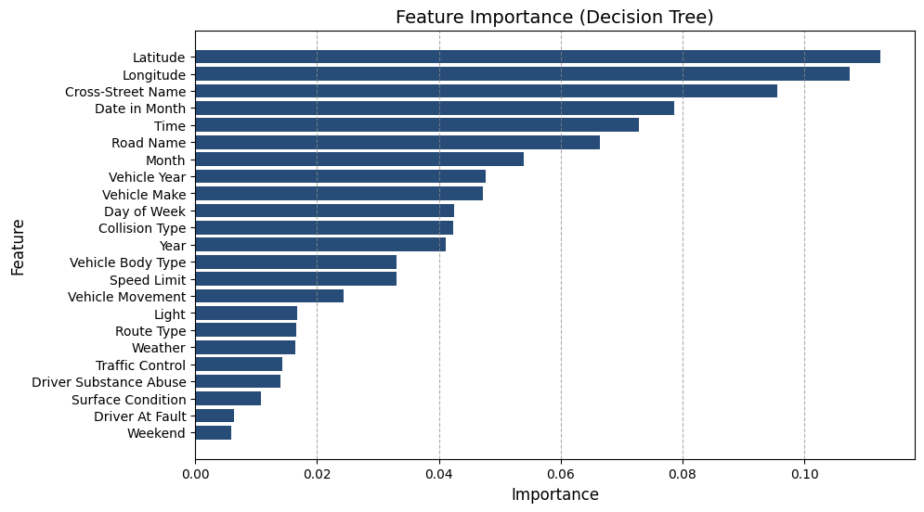
Feature Selection
Applied decision tree model for optimized model input
Objective:
Identify the most relevant features to improve model accuracy and efficiency.
Methods Used:
Decision Tree Feature Importance:
Ranked features based on importance scores.
Business Logic:
Retained features based on domain relevance.
Final Selected Features:
Extracted insights into the most significant factors driving the classifications.
Latitude, Longitude, Time, Day of Week, Month,Weather, Lights, Road Name, Traffic Control, Speed Limit, Driver Substance Abuse, Collision Type.

Slide 10
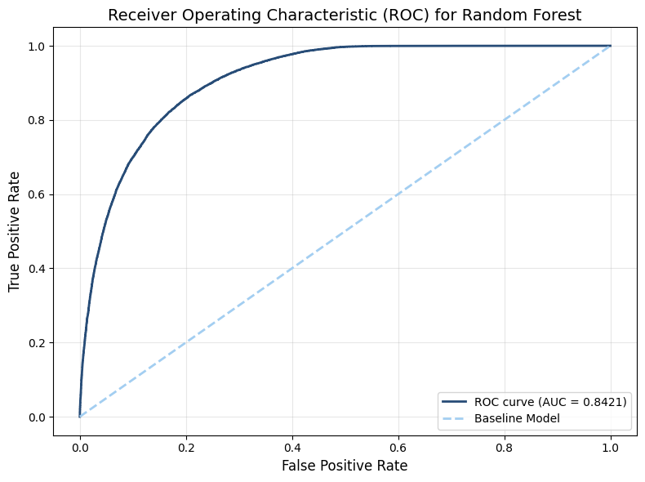
Random Forest Model
The Random Forest Model provides robust performance for multi-class crash severity prediction due to its ability to handle class imbalance, reduce overfitting through ensemble averaging, and capture complex interactions among features
Objective
Leveraging its ability to handle complex feature interactions, mitigate overfitting through ensemble learning, and effectively manage class imbalance
Step 1
Data Preparation
Handle missing values and encode categorical variables. Define the target variable (ACRS Report Type) and apply SMOTE to oversample the minority classes in the training data.
Step 2
Model Training
Configure key hyperparameters like n_estimators and min_samples_leaf based on the complexity of the data. Use the training dataset (X_train and y_train) to fit the Random Forest model.
Model Evaluation
Evaluate performance by generating metrics including precision, recall, F1-score, and accuracy. Compute AUC and plot the ROC curve for multi-class performance analysis.
Step 3

Slide 11

Random Forest Model
Interpretation
Random Forest Metrics
Accuracy (0.7515)
75.15% of predictions made by the Random Forest model are correct. The model has moderate predictive power, it correctly predicts a majority of the instances.
Precision (0.7527)
Of all the instances the model predicted as a certain severity 75.27% were correctly classified. The model is moderately good at avoiding false positives.
Recall (0.7515)
Of all the actual instances of a particular severity, 75.15% were correctly identified. The model is moderately good at avoiding false negatives.
F1-Score (0.7520)
The metric balances the trade-off between precision and recall. A score of 75.20% suggests the model performs similarly in identifying true positives while avoiding false positives and negatives.
ROC-AUC Score (0.8421)
The model's ability to distinguish between classes is 84.21% when considering all thresholds for prediction probabilities. The score is considered high, the model performs well in ranking the probabilities of predictions.
Accuracy | 0.7515
Precision | 0.7527
Recall | 0.7515
F1-Score | 0.7520
ROC-AUC Score | 0.8421
Notes:
GPS - alert (75.15%)

Slide 12
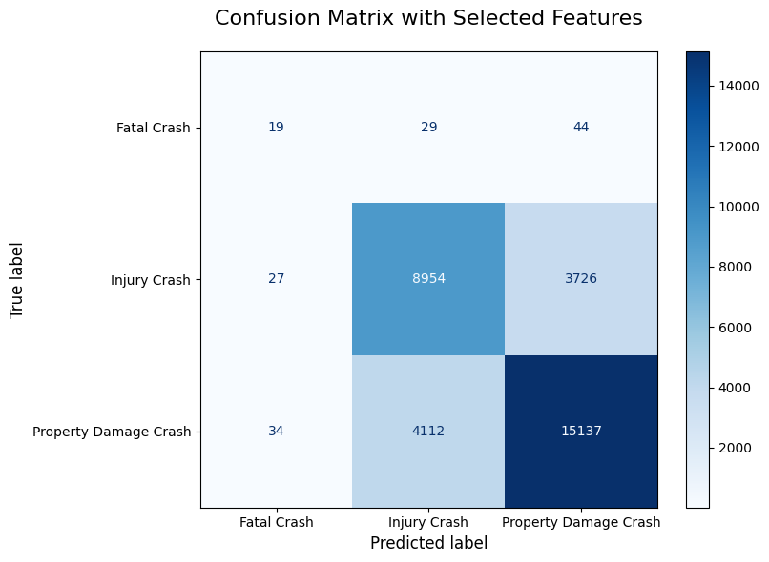
Random Forest Model
Confusion Matrix
Interpretation
Row 1 (Fatal Crash)
- 19 instances of fatal crashes were correctly classified as fatal crashes
- 29 fatal crashes were misclassified as injury crashes
- 44 fatal crashes were misclassified as property damage crashes
Row 2 (Injury Crash)
- 8954 injury crashes were correctly classified as injury crashes
- 27 injury crashes were misclassified as fatal crashes
- 3726 injury crashes were misclassified as property damage crashes
Row 3 (Property Damage Crash)
- 15137 property damage crashes were correctly classified
- 34 property damage crashes were misclassified as fatal crashes
- 4112 property damage crashes were misclassified as injury crashes
Notes:
Row 1, there are some room for improvement

Slide 13
Conclusion
Random Forest Model is chosen as the final model for implementation after comprehensive evaluation
Insights
Latitude, Longitude, Time, Day of Week, Weather, Light, Speed Limit, Collision Type and so on are regarded as the significant contribution to the predictions.
Implementing stricter traffic controls in areas with frequent severe crashes.
Enhancing road lighting and visibility during adverse weather conditions.
Increasing public awareness campaigns regarding the risks of substance abuse while driving.

Slide 14
Appendix

Slide 15
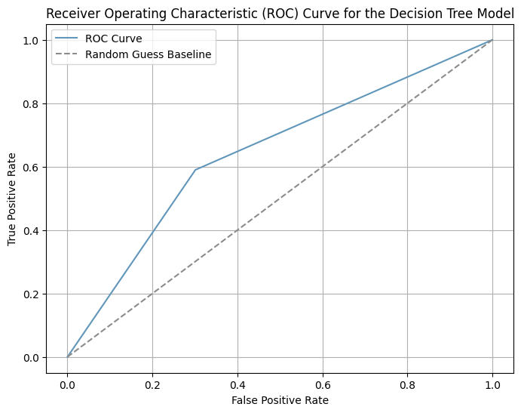
Decision Tree for Interpretable Classification
A Decision Tree is a popular machine learning model used for classification and regression tasks. It mimics human decision-making processes and represents decisions and possible outcomes in a tree-like structure.
Objective:
Use a Decision Tree model to classify traffic collision types
Steps:
Step 1 Data Preprocessing
Encoded categorical variables and target variables using LabelEncoder.
Step 2 Model Setup
Applied selected features.
Balanced the dataset using SMOTE.
Step 2 Model Training
Configured a Decision Tree with selected features.

Slide 16
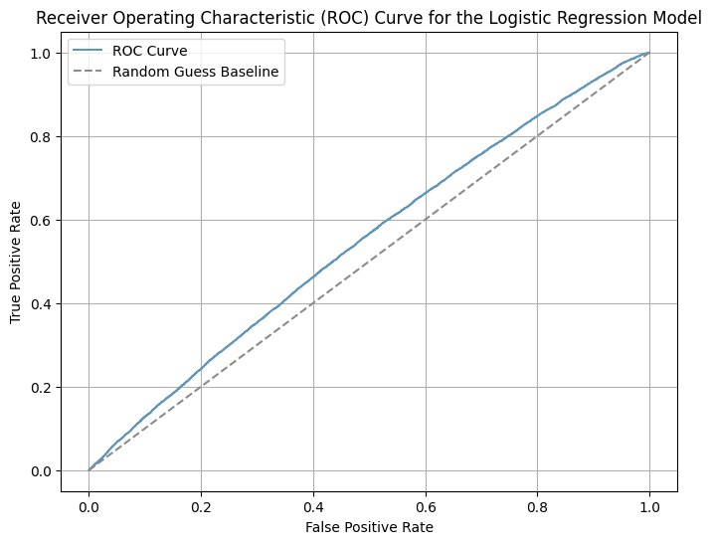
Logistic Regression for Predictive Modeling
Logistic Regression is a statistical method and a widely used machine learning algorithm for binary classification problems.
Objective:
Predict the likelihood of traffic collisions at a specific location.
Steps:
Step 1 Data Preprocessing
Encoded categorical variables using LabelEncoder.
Scaled numerical features using StandardScaler.
Step 2 Class Imbalance
Handled using SMOTE to oversample minority classes.
Step 3 Model Training
Used OneVsRestClassifier to train a Logistic Regression model.

Slide 17
Model Comparison (Decision Tree VS. Logistic Regression)
Decision Tree Evaluation Metrics
Accuracy | 0.6513
Precision | 0.6562
Recall | 0.6513
F1-Score | 0.6534
ROC-AUC Score | 0.6136
Logistic Regression Evaluation Metrics
Accuracy | 0.3936
Precision | 0.5722
Recall | 0.3936
F1-Score | 0.4610
ROC-AUC Score | 0.6060

Slide 18
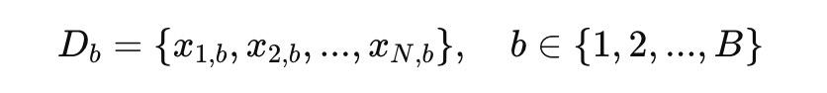
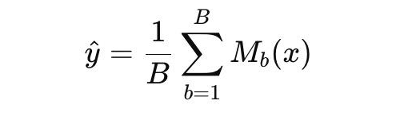
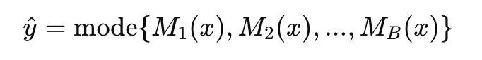
Random Forest
Ensemble Learning Technique
Random Forest is an ensemble learning algorithm that combines multiple decision trees to improve the stability, accuracy, and generalization of machine learning models. Each tree is trained on a different subset sample, and the predictions are aggregated to produce the final output.
Definition
Sampling
Model Training
Aggregation
Formulation
Multiple decision trees are trained independently, each using a bootstrap sample and a subset of features at every split.
B: the number of models to be trained
Reduction of Overfitting: By averaging predictions, Random Forest reduces overfitting in individual decision trees.
Improved Accuracy: Aggregation improves prediction accuracy, especially for high-variance datasets.
Handles Missing Data: Random Forest can maintain performance even with incomplete data.
Advantages
Limitations
Computational Complexity: Training multiple decision trees can be time-intensive for large datasets.
Reduced Interpretability: While each tree is interpretable, the aggregated model lacks transparency.
17
Notes:
MAE (Mean Absolute Error ) :
Definition :
Characterizes the alteration among the original and predictable values . It is mined as the dataset’s total alteration mean.
The Formula :
It is calculated by the absolute difference between actual and predicted divided by the total number of observations.
Advantages :
Unlike RMSE, the changes in MAE are linear and therefore intuitive.
Mathematically amenable to decomposition : Part of that historical preference for sums-of-squares measures is that they are mathematically amenable to decomposition and one can then form ratios, such as those based on separating MSE into its systematic and unsystematic components.
Limitations :
May not adequately penalize large errors :
Puts less emphasis on the extreme discrepancies between forecasted and observed values.
MAE has a specific meaning and it is loosely related to RMSE because it puts less emphasis on the extreme discrepancies between forecasted and observed values
RMSE :
RMSE is more sensitive to outliers because it squares the errors before averaging them, which can make it more suitable than MAE in situations where it's important to penalize large errors more heavily.

Slide 19
Bootstrap Aggregating (Bagging)
The advanced machine learning model combines multiple versions of model with training on a different bootstrap sample.
Bagging: Bootstrap Aggregating
It is an ensemble learning technique designed to improve the stability and accuracy of machine learning algorithms. It works by creating multiple versions of a model, each trained on a different bootstrap sample (random subset with replacement) of the training data.
Definition
Bootstrap Sampling
Model Training
Aggregation
Formulation
A base model M_{b}​ is trained on each bootstrap sample D_{b​}.
B: the number of models to be trained
Reduction of Overfitting: Bagging reduces overfitting by averaging predictions from multiple models, especially for unstable learners like decision trees.
Improved Prediction Accuracy: Combining predictions from multiple models often leads to better generalization compared to individual models.
Advantages
Computational Complexity: Training multiple models increases computational and memory requirements, which can be expensive for large datasets or complex base models.
No Bias Reduction: Bagging does not address issues of high bias in base learners. If the base model is consistently inaccurate, Bagging will propagate this flaw across all ensemble models.
Limitations
17
Notes:
MAE (Mean Absolute Error ) :
Definition :
Characterizes the alteration among the original and predictable values . It is mined as the dataset’s total alteration mean.
The Formula :
It is calculated by the absolute difference between actual and predicted divided by the total number of observations.
Advantages :
Unlike RMSE, the changes in MAE are linear and therefore intuitive.
Mathematically amenable to decomposition : Part of that historical preference for sums-of-squares measures is that they are mathematically amenable to decomposition and one can then form ratios, such as those based on separating MSE into its systematic and unsystematic components.
Limitations :
May not adequately penalize large errors :
Puts less emphasis on the extreme discrepancies between forecasted and observed values.
MAE has a specific meaning and it is loosely related to RMSE because it puts less emphasis on the extreme discrepancies between forecasted and observed values
RMSE :
RMSE is more sensitive to outliers because it squares the errors before averaging them, which can make it more suitable than MAE in situations where it's important to penalize large errors more heavily.

Slide 20
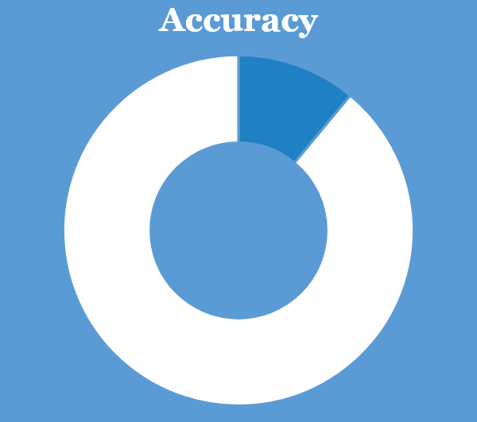
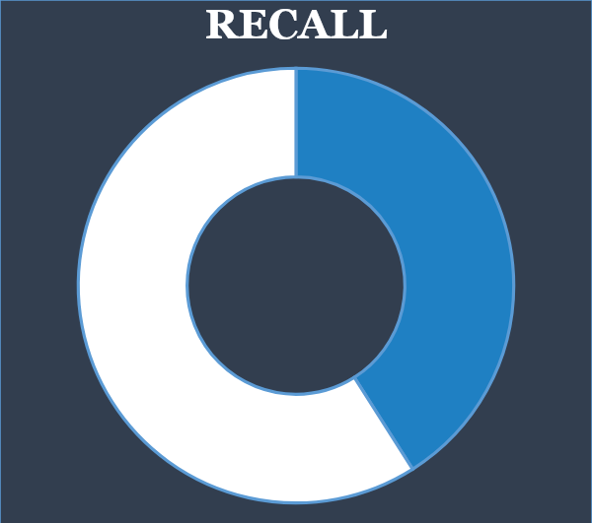
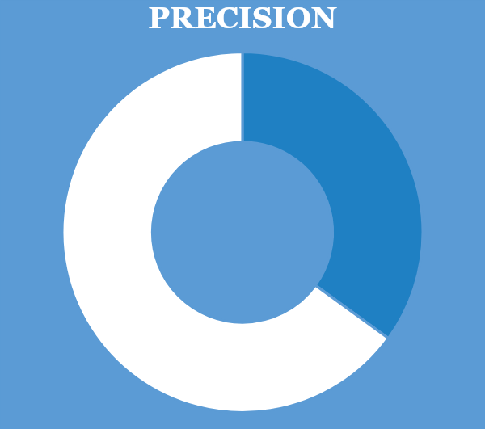
Results of the Bagging Model
Evaluation – Bagging with n_estimators=10 and random_state=1
52%
52%
53%

Slide 21
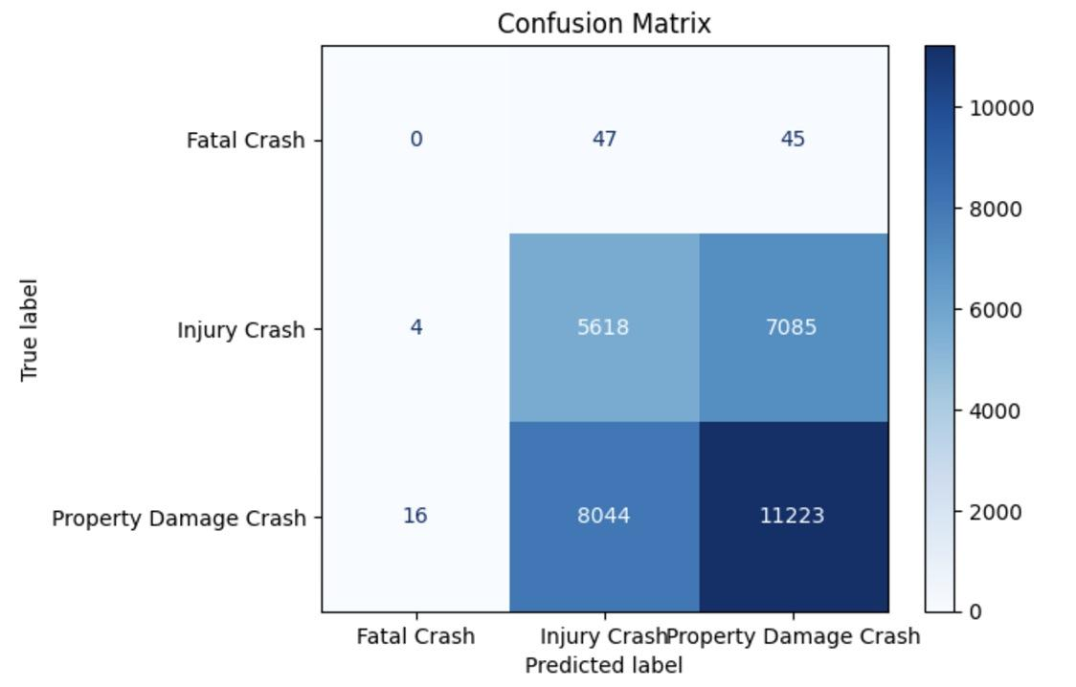
Bootstrap Aggregating (Bagging)
Bagging struggles significantly with identifying fatal crashes.
Confusion Matrix
Insights
The confusion matrix of the Bagging model
Fatal Crashes: The model struggles significantly with identifying fatal crashes
Injury Crashes: the model has overlapping features between "Injury Crashes" and "Property Damage Crashes," reducing its classification performance.
Property Damage Crashes : while the model performs decently for this class, there is still considerable confusion with the "Injury Crashes" class

Slide 22
AdaBoost(Adaptive Boosting)
Ensemble Learning Boosting Algorithm
What is AdaBoost?
AdaBoost is an ensemble learning technique that combines multiple "weak learners" into a single "strong learner" to create a model with better predictive performance.
Key Characteristics
Boosting: Sequentially training weak learners, where each learner focuses more on the examples that were previously misclassified.
Adaptive: Iterative training process. The weights of incorrectly classified examples are increased at each iteration.
Weight Assignment: AdaBoost assigns weights to each training instance. After each iteration, the weights of misclassified instances are increased so that the next weak learner pays more attention to them.
Final Prediction: based on a weighted vote of all the weak learners.
Training Steps
Initialize weights Train weak learner Evaluate weak learner Update weights Repeat Combine weak learners
Pros and Cons
Pros
Works well with many types of weak learners, especially decision trees.
Can reduce bias and variance in predictions.
Cons
Sensitive to noisy data and outliers because it assigns higher weights to difficult examples, which might include noise.
Can overfit if not tuned properly.

Slide 23
AdaBoost - Model Training
With Cross Validation and Fine Tuning
Perform a coarse grid or random search for hyperparameters on the train.
Use fewer cross-validation folds
Identify the most promising parameter ranges.
Coarse Search
Apply SMOTE on train data
Find Best Parameters
Train using best parameters
Use the best parameters from the coarse search as the starting point.
Define a finer grid around the promising ranges.
Perform grid or random search on the full dataset and increase folds number.
Refine Search

Slide 24

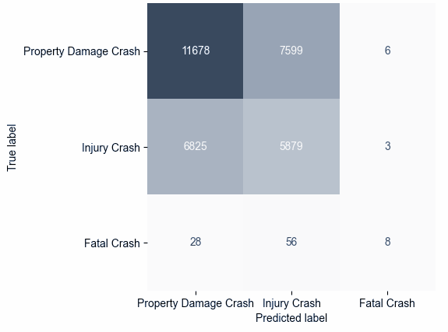
AdaBoost - Performance
Not performing well with identifying fatal crashes.
Confusion Matrix
Test Recall Score
61% of actual Property Damage Crash are correctly predicted.
47% of actual Injury Crash are correctly predicted.
Only 24% of actual Fatal Crash are correctly predicted.

Slide 25
XGBoost(eXtreme Gradient Boosting)
Supervised Machine Learning Algorithm
What is XGBoost?
XGBoost is based on the gradient boosting framework and widely used for both regression and classification tasks.
Key Characteristics
Ensemble: XGBoost builds an ensemble of decision trees in a sequential manner.
Each tree attempts to correct the errors made by the previous ones by minimizing a loss function through gradient descent.
Parallel Computing: supports parallelization, which makes it much faster than traditional gradient boosting implementations.
Sparsity Awareness: handle missing values and sparse data efficiently.
Pruning: control tree growth and implements a process called "tree pruning" to avoid overfitting.
Training Steps
Apply SMOTE Find best parameter using cross validation Fit XGBoost Model Evaluate Test Performance
Pros and Cons
Pros
High speed and accuracy compared to other algorithms.
Works for both classification and regression tasks and even supports ranking and survival analysis.
Cons
can overfit on small or noisy datasets if not carefully tuned.
Long training times for large datasets.

Slide 26
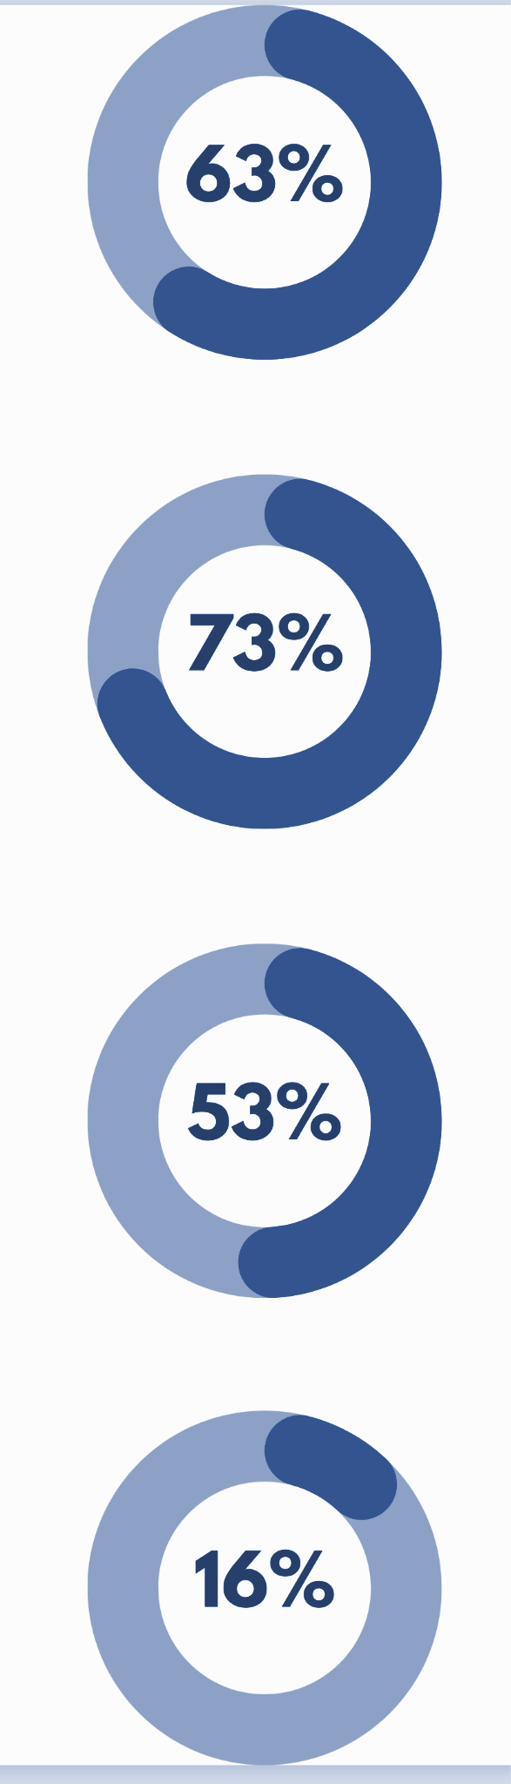
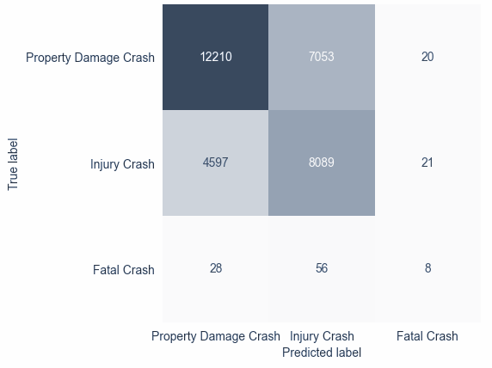
XGBoost - Performance
Not performing well with identifying fatal crashes.
Confusion Matrix
Test performance
Accuracy: The model is correct 63% of the time across all classes.
When the model predicts Property Damage Crash, it is correct 73% of the time.
When the model predicts Injury Crash, it is correct 53% of the time.
When the model predicts Fatal Crash, it is correct only 16% of the time.

